Slide 1


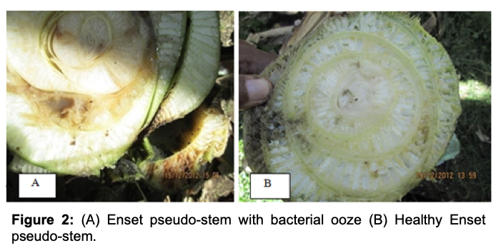
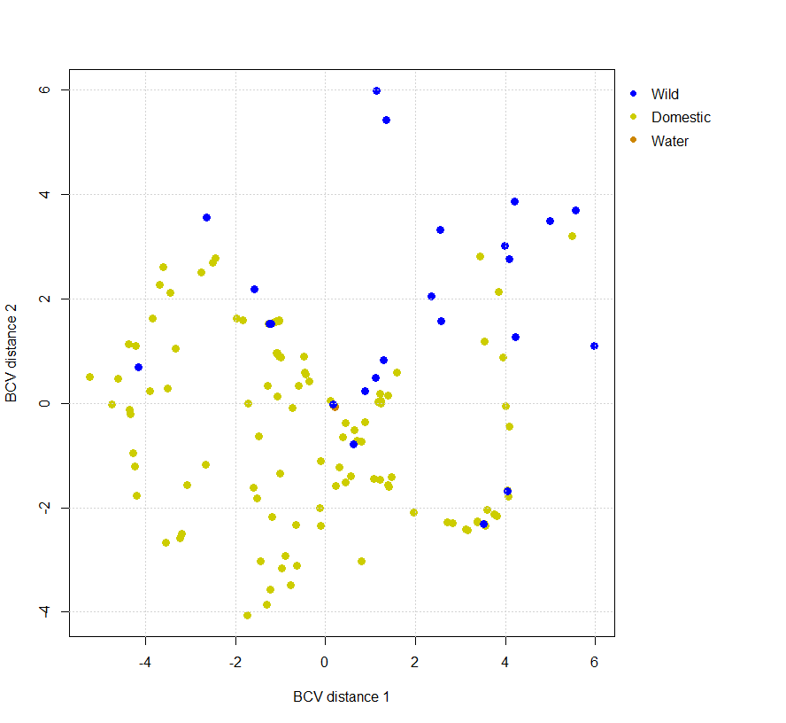
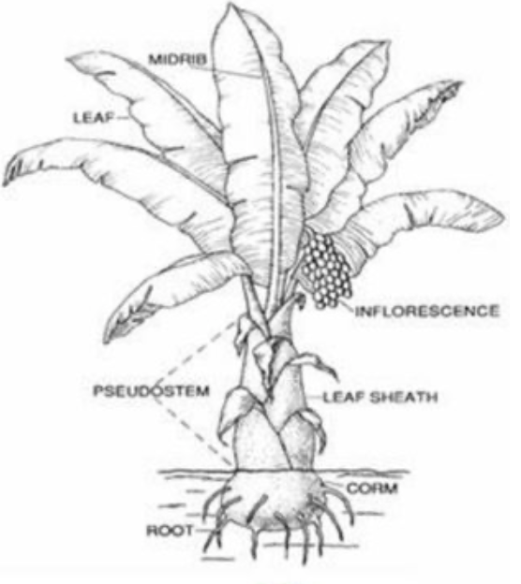
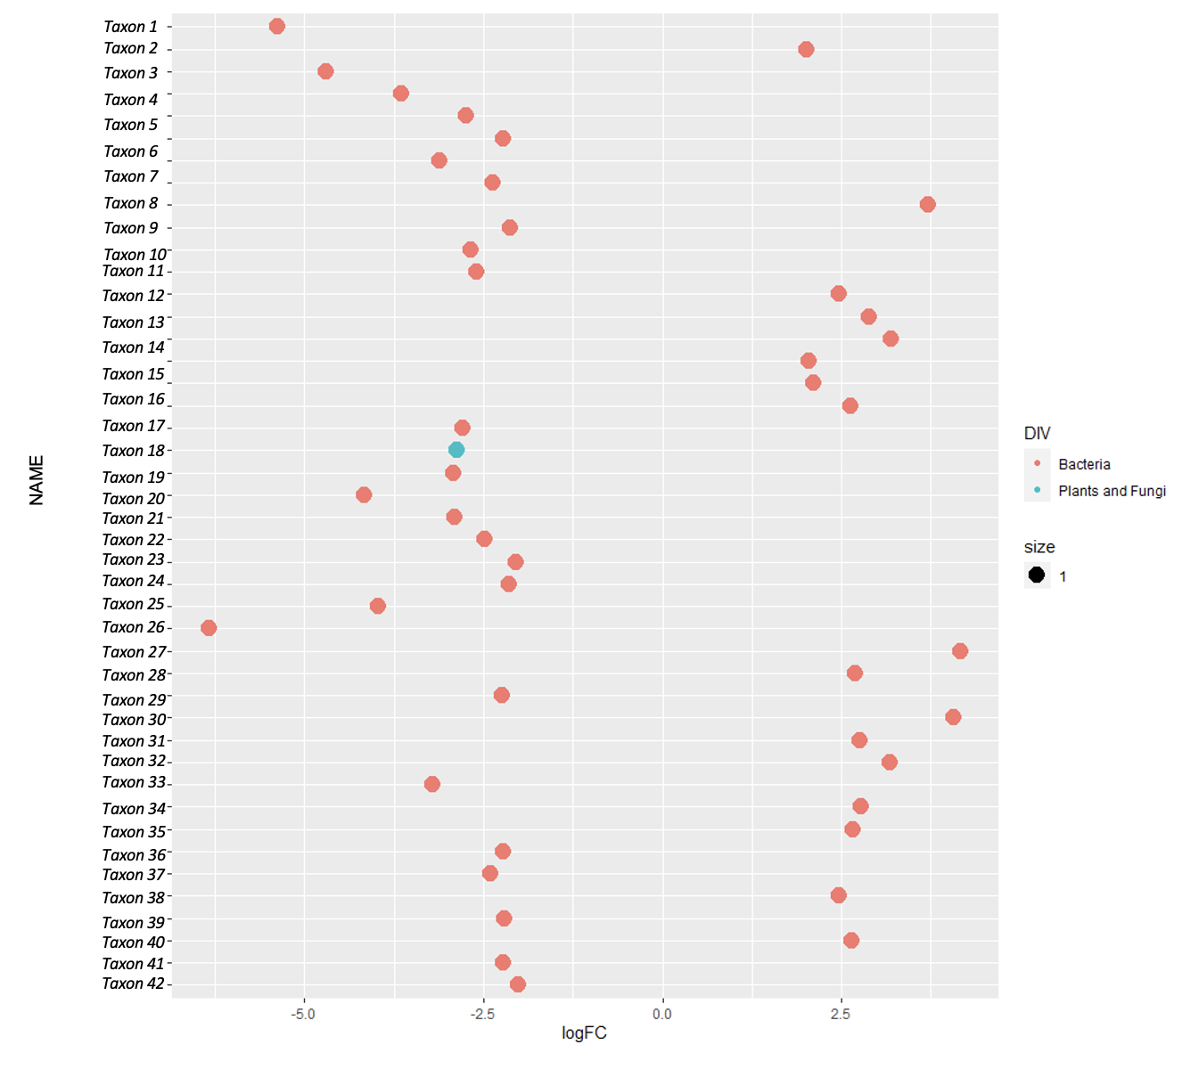
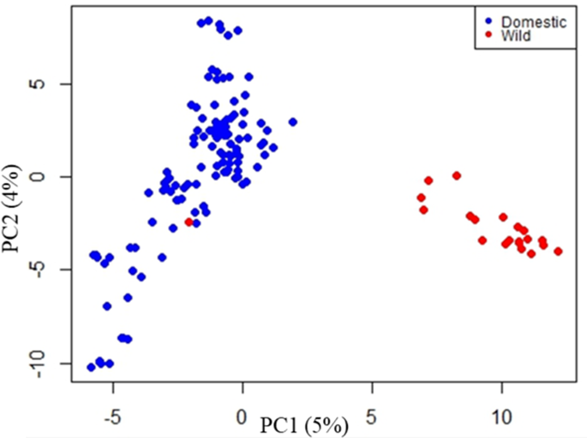

Repurposing Next Generation Sequencing Data for a More Sustainable Agriculture: Enset a case study
Bridget A. Bolt, Kiflu Tesfamicael, Lakshay Anand, Carlos M. Rodríguez López
University of Kentucky, Department of Horticulture
Introduction
Approach
Results
Conclusion and Further Research
Background: One main challenge to modern agriculture resides on reducing its environmental impact while maintaining yield and quality. Healthy microbiomes provide services to plants by protecting them against disease and environmental insult. The development of new varieties with enhanced microbiome host capabilities has potential to increase sustainability by reducing use of non-renewable agronomic inputs (e.g. water, fertilizers, and pesticides)¹. To achieve this, it is paramount to first determine what are differences between microbiotas of the target crop and its wild counterparts, and then to identify what genes control plant microbiome assembly have been affected by domestication. Almost all current approaches used to characterize plant associated microbiotas are based on Next Generation Sequencing technologies. Equally, genotyping of large populations required for marker-assisted breeding is normally achieved using Next Generation Sequencing approaches. The development of a technique that concurrently provides both microbiota and host genotype information would reduce both time and cost associated to future projects aimed at the development of new crop varieties with enhanced host capabilities².
Project goals:
1. Test if Genotyping By Sequencing (GBS) data generated to genotype crop accessions, could be repurposed to characterize the microbiota of such individuals.
2. Characterize the leaf endobiome of cultivated and wild enset accessions
Enset, a case study: Enset (Ensete ventricosum (Welw.) Cheesman) is a crop that belongs to the Musaceae family (Fig.1). Enset is thought to have been domesticated in Ethiopia². Previous research characterized the genetic differences between cultivated and wild enset using GBS data from 149 accessions (Fig 2)³.
Fig 2. Analysis of genetic variability of enset in Ethiopia. Principal component analysis using 5169 GBS-based SNP markers generated from 120 cultivated and 21 wild enset accessions. Modified from³.
Field work: Leaf samples were collected from 149 enset samples (125 domestic and 24 wild) growing in six of the major enset producing regions in Ethiopia: Dawro, Guragie, Keffa, South Omo, Sheka, and Sidama³. Samples were collected from internal unfolded leaves in the growing apex of selected plants (Fig 3).
Wet laboratory work: GBS libraries were prepared as described in³.
1. DNA was extracted using DNeasy Plant Mini Kit (Qiagene Inc.).
2. 200ng of DNA/sample were restricted using two enzymes (EcoRI & MspI).
3. Individually-barcoded sequencing adapters were ligated to the restriction products using T4 Ligase.
4. Ligated products (n=149 plant samples 1 Control water) were equimolarly pooled into two mixes each containing 75 sample and amplified using PCR.
5. Resulting PCR products were size selected and sequenced using two Illumina NextSeq High Output 75 bp single-end runs.
Dry Laboratory Work:
1. A bioinformatics pipeline was designed and implemented to characterize the presence of microbial species in the published GBS data (Fig 4)
1. 2 Million USTs were identified
2. Approximately less than 1% (15,000) of USTs passed the sequence similarity thresholds to be considered as belonging to microbial species that constitute enset endo-biome
3. Multidimensional Scaling (MDS) analysis shows a relative separation in the relative abundance of putative microbial USTs in wild and domestic enset genotypes (Fig 5)
There are two main factors that are hypothesized to impact plant microbial communities: the environment and the host genome. Previous research has shown that domestication of the Ethiopian crop enset resulted in a genetic differentiation between wild and cultivated accessions. The concurrent generation of genotyping and microbiome data from large number of samples can be used in the future to identify plant loci associated to the assemblage of microbial communities, which can be used for future breeding programs. Our results suggests that:
1. GBS data, originally created to genotype multiple accessions in parallel, contain information that can be used to characterize the plants microbiome and.
2. There are significant differences in the composition and the relative abundance of microbial communities between wild and domestic accession.
The results presented here could be used to support previous evidence of the host genome controlling its associated microbial communities. Additionally, our approach could be implemented in already freely available GBS datasets from different crops to identify what are the genes controlling microbiota assembly, which would result in the identification of possible breeding targets for future of breeding programs aimed at developing more efficient microbiome hosts.
Future work: We have identified two steps that need to be implemented for the streamlining and validation of the proposed methodology.
1. It is possible that some of the USTs deemed microbial (specially those deemed bacterial in origin) could be part of the enset genome (in particular from the mitochondria or chloroplast). An intermediate step should be included in which every sequence mapping to the enset genome⁵ will be eliminated. This will leave the bacterial and fungal sequence that happened to be found in not solely the genome of the wild type or cultivated enset.
2. The allocation of USTs to microbial taxa needs to be validated using an established and proven methodology (i.e. using barcoding genes (16S/18S ribosomal Gene Sequencing or metagenome assembly).
Fig 3. Top view of an enset apical meristem cut for sample collection. Only samples from inner unfolded leaves that had not been exposed to the environment were collected for this study in order to reduced environmental contamination of the leaf endobiome.
Project hypothesis: We hypothesize that genetic differences between wild and cultivated enset will result in differences in the relative abundance of microbial taxa in their associated microbiota.
To test our hypothesis and achieve our goals we used published GBS data from 149 wild and cultivated accessions of the Ethiopian crop enset³.
Fig 5. Analysis of the leaf endobiome of wild and cultivated enset. MDS plot containing the relative abundance of 40,000 USTs deemed part of the enset endobiome in wild and cultivated enset accessions.
4. The relative abundance of 42 USTs (41 and 1 allocated to bacterial and fungal taxa respectively) were significantly different (FDR <0.05) between wild and domestic accessions (Fig 6)
GBS data was QC, demultiplexed and trimmed to generate a unique data set for each of the samples
Unique sequencing tags (USTs) were identified and quantified for each sample
A local database containing all bacterial and fungal currently available genome sequences at NCBI was created to BLAST identified USTs
Reads presenting similarity > e⁻²⁰ & match- mismatch values= 1-2 were considered matches for the given microbial species
Microbe relative abundance was inferred for each sample standardizing the number of USTs present by the total number of reads in each sample
References
1. Corbin, K. R., Bolt, B., Rodriguez Lopez C.M. 2020. Breeding for Beneficial Microbial Communities Using Epigenomics. Frontiers in Microbiology, vol. 11.
2. Solomon Tamrat, Borrell, J. S., Biswas M. k. et al. 2020. Micronutrient composition and microbial community analysis across diverse landraces of the Ethiopian orphan crop enset. BioRxiv 834564;
3. Guzzon, F. & Müller, J. V. 2016. Current availability of seed material of enset (Ensete ventricosum, Musaceae) and its Sub-Saharan wild relatives. Genet. Resour. Crop Evol. 63, 185–191.
4. Tesfamicael, K. G., Gebre, E., March, T. J., Sznajder, B., Mather, D., Rodriguez Lopez, C. M. 2020. Accumulation of Mutations in Genes Associated with Sexual Reproduction Contributed to the Domestication of a Vegetatively Propagated Staple Crop, Enset. Horticulture Research.
5. Harrison, J., Moore, K. A., Paszkiewicz, K., et al. 2014. A Draft Genome Sequence for Ensete ventricosum, the Drought-Tolerant “Tree Against Hunger”. Agronomy, 4(1), 13-33.
Fig 1: Depiction of a cultivated enset plant.
Acknowledgements
I want to thank Dr. Carlos Rodriquez Lopez for mentoring me throughout this project. Along with Lakshay Anand for his support and guidance with bioinformatic analysis. The Student Sustainability Council and Undergraduate research for supporting this fellowship.
Fig 4. Bioinformatics pipeline designed for the identification of microbial sequences in GBS data.
Fig 6. Identification of significantly different abundant USTs in wild and domestic enset accessions. Horizontal axis shows the fold chance in abundance of bacterial (orange) or fungal (blue) USTs significantly different between domestic and wild accessions.
You can download this poster by scanning this QR code

